Slide 1

SIAM Knights Python Workshops
Utilizing GitHub
04/04/2021
Hanna Reed
An introduction to using GitHub for personal use and collaboration.

Slide 2
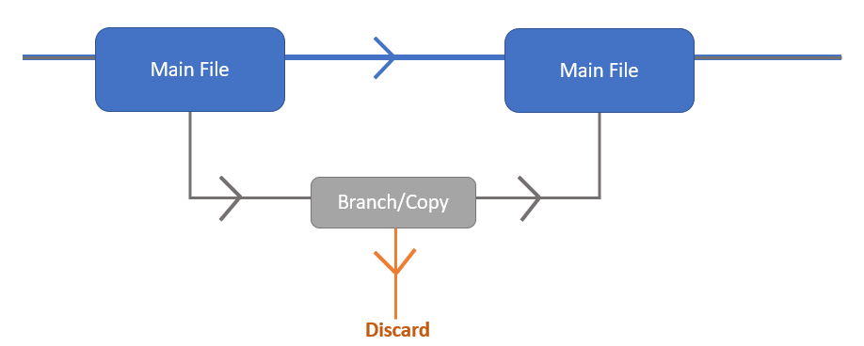
Why would I use this?
Provides version history with easy navigation
Allows code synchronization between machines
Create branches (a temporary copy that can either be merged or discarded)
Easy collaboration on shared projects (reason for creation)

Slide 3
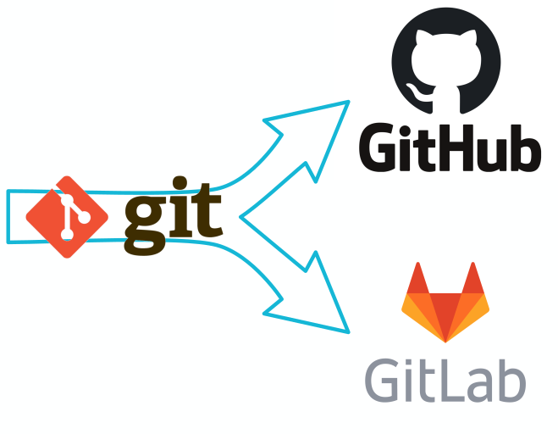
Some things to keep in mind
Git vs GitHub
Git – software that preforms the actions
GitHub – a place to store your code and provides a web interface to preform git functions (add file, push, pull, merge, etc.)
Git is to GitHub as Python is to Spyder
This talk will contain A LOT of information, some of which may be rather confusing
Ask questions, follow along, and practice afterwards
This presentation will be made available to you!
WARNING: if you like to work ahead, do so at your own risk. I may not have time to answer your questions if something goes wrong while working ahead.

Slide 4
Order of Events:
Setting up GitHub account
Create your first repository
Intro to Sublime Merge (my choice, you can choose something else) - update as you work
Taking advantage of other work on GitHub – forking
Collaboration on GitHub – shared repositories, branches, pull requests, issues

Slide 5

Set-Up
This will be a follow along workshop
Please make a GitHub account or login to your current account if you want to follow along!
(recommended)

Slide 6


Creating your first repository!!
A repository will host all the files for your project (or multiple projects) in one space.
Main page >> repositories >> new
README.md : tells others what's going on and provides documentation space for you
.gitignore : tells git which files to ignore (the hidden, back-end ones) you can choose a template based on the coding language you will be using – choose python for our purposes.
Licenses : tells other what they can do with your repository https://docs.github.com/en/github/creating-cloning-and-archiving-repositories/licensing-a-repository

Slide 7
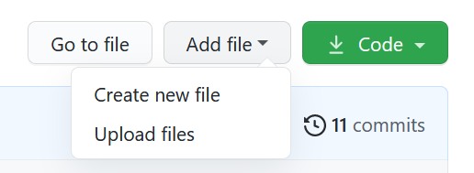
Adding Files – the upload
You can add files to your repo via upload from your machine
Try uploading a file from your computer to the repo you just created
If you want an example file, I posted one in the discord *note – you will need to download to your PC and then upload to GitHub*
Okay cool – we can make collections of files … but is this the extent??

Slide 8
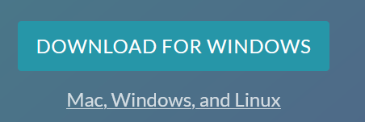
Sublime Merge
This is a Git Client which allows you to update your repo’s as you edit them on your PC … meaning … no uploading, no copy/pasting, and your GitHub files stay up to date!
Please download: https://www.sublimemerge.com/
There are other options; however, this is the one I know use and will be showing. After this workshop, you are free to browse others

Slide 9
How to use?
Open Sublime Merge on your computer
Clone the repo you have already created in GitHub (watch me and then try yourself) note, sublime will ask you to sign-in so that it can connect to your GitHub account
main and origin/main
Origin is the first instance of your repo (by default)
Let’s make some changes! (watch me and then try yourself)
Which we will do right now

Slide 10
README.md
Your readme will provide yourself and others some context to the files you have in each repository (and even each folder in the repository)
Open the README.md file on your computer
You can open in notebook, sublime text, or whatever text editor you like
Use the Markdown language to write your readme file
# and ## for headers
* and ** for italic and bold
Lots more – https://guides.github.com/features/mastering-markdown/
Let’s push our changes to the GitHub using Sublime Merge! (watch me first)
Check out your edits on GitHub!

Slide 11
Version History
Initial
2
3
Current
Make changes on your local file
Go to Sublime Merge:
Stage the modified file
Write a commit message
Commit
Make changes on your local file
Go to Sublime Merge:
Stage the modified file
Write a commit message
Commit
Go to Sublime Merge:
Checkout previous version
Detached head!
Checkout current version

Slide 12
Push your modifications to GitHub
Go to Sublime Merge:
Push
Look at your modifications on GitHub

Slide 13
Pull modifications from GitHub
Go to GitHub and open your file
Make some modifications >> commit
Go to Sublime Merge:
Pull
Check out your modifications on your local repository

Slide 14



What about conflicts?
Make a local edit
Go to Sublime Merge:
Stage >> comment >> commit (don’t push)
Go to GitHub:
Modify file
Commit
Go to Sublime Merge:
Pull
CONFLICT!!!
Resolve ☺
Push
Local Version
GitHub Version

Slide 15
Creating Branches
Experiment without ruining your already awesome work
How can we make a branch?
Got to Sublime Merge:
Create a branch
Notice the pane on the left – the branch you are on is bolded!
Managing conflicts will be the same as before!

Slide 16
Local Branches
Make sure you are on the branch and make some edits
stage >> commit >> DON’T PUSH!
To update main, we must MERGE the branch!
Checkout main
Merge branch to main
Push main and delete branch

Slide 17
Pushed Branches
What if we push the branch to GitHub?
Pushing to GitHub will push your branch to GitHub (it will not update main)
You will have a local branch and the branch in GitHub (just like main!)
Collaborators can see your work and may even work on the same branch!
While you work on the branch, you will push/pull as you did before
Note: main will remain unchanged
Once you are ready, you will merge the branch to main and delete the branch (unless you want to keep it for more experiments)

Slide 18


Collaboration

Slide 19
Collaboration on the same repository
Repository >> settings >> manage access >> invite collaborators
Good practice:
Main is reserved for the “truth” (convention)
Make edits on branches – merge into main once complete
Deal with conflicts – same as before

Slide 20

Collaboration Between Repositories
Fork a repository:
Go to GitHub:
Find the repository: Hannarea, SIAM-Knights-Python-Workshops
Fork it
Clone this repository onto your computer
Collaborate:
Edit something on the repository (add a file, edit the readme, add a comment to the file, delete a file, whatever you want!)
Stage, commit, and push these changes to YOUR copy
Create a pull request from your repository
This will give me the option of updating my repository with your edits!

Slide 21
Review:
Store projects in repositories
Create branches for risk-free editing
Version history
Code synchronization
Easy collaboration on coding projects
Utilize others work via forking

Slide 22


Utilizing GitHub
Join us, 04/04/2021 at 6:00PM for the next SIAM Knights Python Coding Workshop!
(zoom link below)
This week, we will be taking a step back from python, and learning the basics of a very important tool – GitHub!
During the workshop, participants will learn how to:
Manage repositories in their personal account
Utilize a Git Client (an alternative to using git in the command line)
Collaborate on coding projects using GitHub
Why is this helpful:
Easy navigation with version history
Utilize branches for risk-free editing
Easily collaborate on coding projects

